Slide 1
Standards for Mathematical Content
Critical Areas
College and Career Readiness
Notes:
Instructor Notes: 30 seconds
In our ongoing effort to ensure that our students are college and career ready, we will continue our work with the Common Core State Standards.
Today we will begin to unpack the Common Core content standards in the domain of fractions.

Slide 2
District-Wide
2013-14 Math Goals
Collaboratively plan, deliver, reflect upon, and revise instruction that differentiates for all learners and includes the Standards for Mathematical Practice:
  MP1 - Make sense of problems and persevere in solving them
  MP3 - Construct viable arguments and critique the reasoning of others
  MP4 - Model with mathematics
Build understanding of the Common Core instructional shifts focus, coherence, and rigor
Integrate technology in support of teaching and learning
Notes:
Instructor Notes: 1 minute
Listed are the 2013-14 District math goals for schools. Our work in this session will be guided these objectives.
Review slide
Primarily we’ll be focusing on the cycle of plan, deliver, reflect, & revise. Jay McTighe and Grant Wiggins (Understanding by Design - UbD), cite identifying desired results as the first of three stages in strategic backwards planning. Today we’ll be working to understand the standards, our desired results.
Additional Facilitator Information:
Focus: Instruction is focused on grade level standards.
Phil Daro on Focus in Math http://vimeo.com/45730600
The Importance of Focus http://www.youtube.com/watch?v=2rje1NOgHWs&list=PLD7F4C7DE7CB3D2E6
Coherence: Instruction should be attentive to learning across grades and linking major topics within grades.
Rigor: In major topics, pursue with equal intensity conceptual understanding, procedural skill and fluency, and applications.

Slide 3
Session Outcome
Begin to collaboratively unpack a Common Core critical area
Notes:
Instructor Notes: 30 seconds
Review slide

Slide 4
College and Career Readiness
Practice
Standards
Common
Core
Mathematics Standards
Content
Standards
Notes:
Instructor Notes: 1 minute
Here the math CCSS are broken down using a brace map. The brace map helps identify whole and part relationships. It shows the components that make up a whole.
In the same way that blue and red make purple, when practice and content join forces you get the CCSSM.
“The CCSSM include two types of standards: Eight Mathematical Practice Standards (the same at each grade level) and Mathematical Content Standards (different at each grade level). These standards address both “habits of mind” that students should develop to foster mathematical understanding and expertise, and also skills and knowledge – what students need to know and be able to do. The standards also call for mathematical practices and mathematical content to be connected as students engage in mathematical tasks.” – CA Framework, April 2013 Draft
Today we will be exploring the Common Core Standards for Mathematical Content.

Slide 5
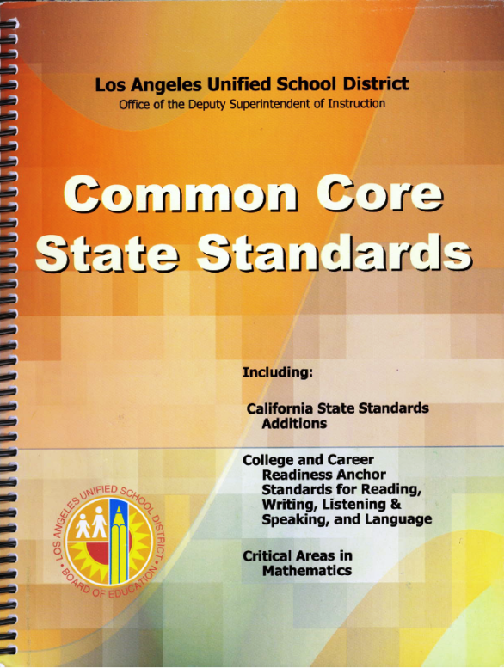
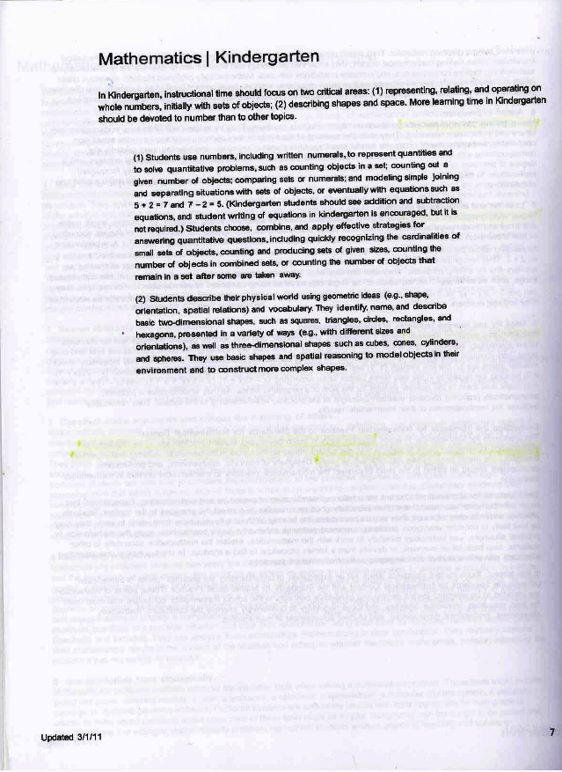
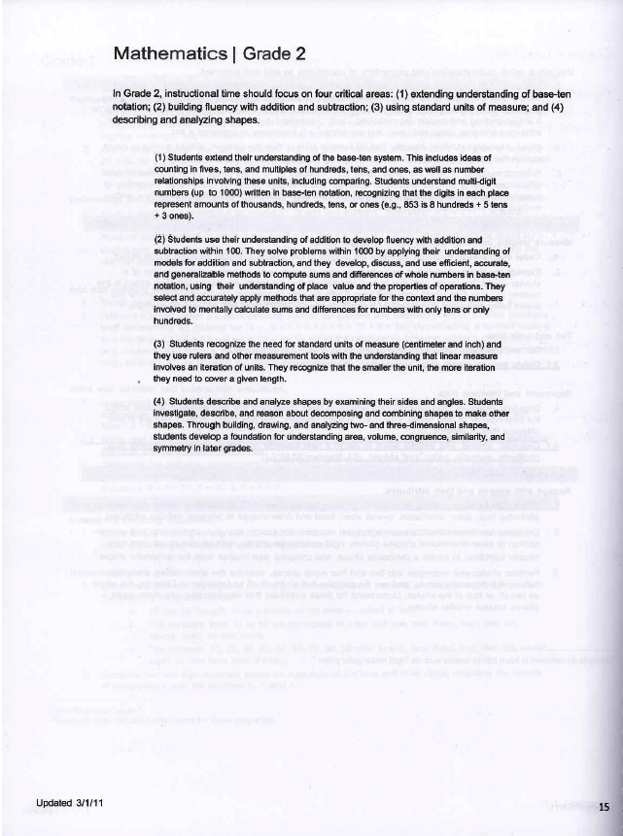
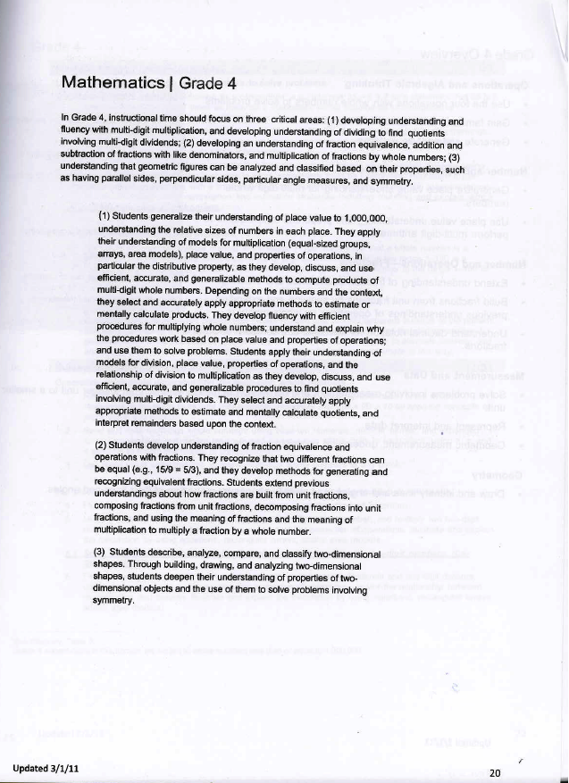
Critical Areas
Focus the content standards at each grade
Describe big ideas to build curriculum and guide instruction
Notes:
Instructor Notes: 1 minute
Outlined on the opening page of grade level standards, critical areas describe two to four big ideas that encompass several grade level content standards.
The critical areas help teachers make instructional decisions by providing a focus for the work to be done at each grade level.
They are not in addition to the standards; rather, critical areas help by grouping and summarizing the most critical skills at each grade level, those around which teachers should plan much of their instructional time throughout the year.
Critical areas are meant to help teachers plan meaningful learning opportunities for their students that connect throughout the school year and form a firm foundation on which to build concepts and procedures in later years.
Today you will explore one of your grade level critical areas, fractions.

Slide 6


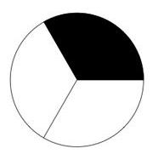
Common Core Geometry
Fractions Foundation
Grade 1
Grade 2
Partition shapes
Partition shapes
Notes:
Instructor Notes: 1 minute
Fractions in grades 1 and 2 are hidden in the Geometry domain. These lay the foundation for the grades 3-5 Common Core domain of Number and Operations – Fractions. First graders are expected to partition circles and squares into two and four equal parts and describe them as halves, fourths, and quarters.
In addition to halves and fourths, in grade 2, students divide shapes into thirds. Second graders are taught to describe a whole as two halves, three thirds, or four fourths.

Slide 7
Common Core Fractions Progression
Grade 3
Grade 4
Grade 5
The meaning of fractions
The number line
Equivalent fractions
Equivalent fractions
Adding and subtracting fractions
Adding and subtracting fractions
Comparing fractions
Comparing fractions
Multiplying and dividing fractions
Mult. of a fraction by a whole #
Multiplication as scaling
Decimals
Notes:
Instructor Notes: 1 minute
Fractions are formally introduced in grade 3. Fractions are a critical area for grades 3-5.
What content is taught in both third and fourth grade? What about fourth and fifth?
Where is the number line introduced and taught?
Please find the Framework handout on your table (grade level specific handout).
This is an excerpt from the August 2013 draft of the California Common Core Framework.
When reading the standards, it’s often hard to imagine the many ways they may be taught and assessed. The framework is a curriculum guide that can help us consider approaches to critical content areas.

Slide 8
Critical Area Read and Connect
Grade 2: Form groups of three and letter off A-C
Grade 3: Form groups of three and letter off A-C
Grade 4: Form groups of four and letter off A-D
Grade 5: Form groups of four and letter off A-D
Notes:
Instructor Notes: 2 minutes
We are now going to move into grade-alike teams so that we can collaboratively unpack our CC grade level standards.
You will need to take your name tent, student/teacher/diverse learner tree map, and a pencil.
Grades 2 and 3 will form grade-alike teams of three.
Grades four and five will form grade-alike groups of four.
Once we are in teams, we’ll letter off.

Slide 9
Critical Area Read and Connect
Everyone reads individually to first stopping point
  A’s summarize
  Group generates connections and applications and records
Repeat the pattern with “B,” “C” and “D” summarizing for the remaining sections
Notes:
Instructor Notes: 2 minutes
Because the standards are complex texts and require close reading, today we will engage in "Read and Connect,” an activity designed for summarizing and synthesizing from “Groups at Work.”
Review slide
We will record takeaways on your student, teacher, diverse learner tree map.
Who can restate what we are about to do?
Pass out the framework readings to grade level groups once you are sure the directions are understood.

Slide 10
Critical Area Read and Connect
Grade 2 Stopping Points
Line 612
Line 622
Line 643
Grade 3 Stopping Points
Line 304
Line 328
Line 366
Grade 4 Stopping Points
Line 379
Line 428
Line 447
Line 478
Grade 5 Stopping Points
Line 353
Line 389
Line 404
Line 413
Notes:
Instructor Notes: 30-35 minutes
Review slide
After about 30 minutes, elicit salient student, teacher, & diverse learner takeaways whole group.

Slide 11
Read and Connect
Exercise Debrief
What themes emerged?
How might this exercise contribute to group development?
When considering classroom application of this exercise, what might you add to meet the needs of our diverse learners (EL, SEL, SWD, At-Risk, GATE)?
Notes:
Instructor Notes: 2 Minutes
Review the slide to debrief the Read and Connect protocol.
Consider asking different groups to TPS one of the three questions.

Slide 12
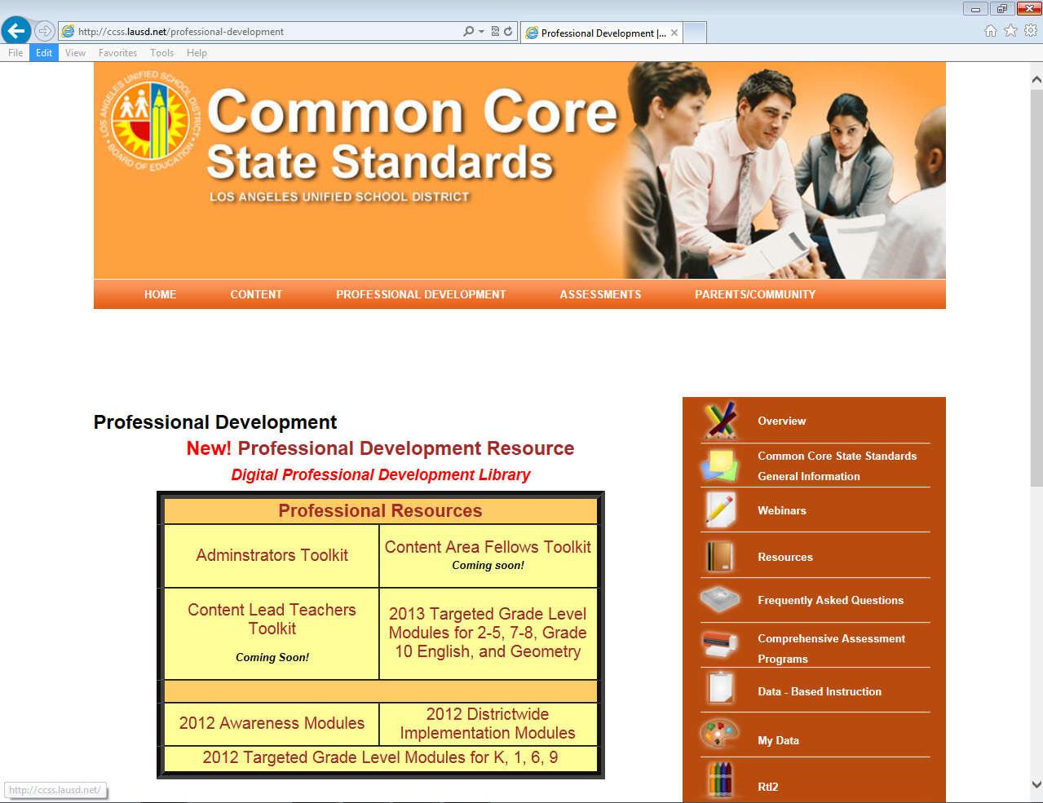
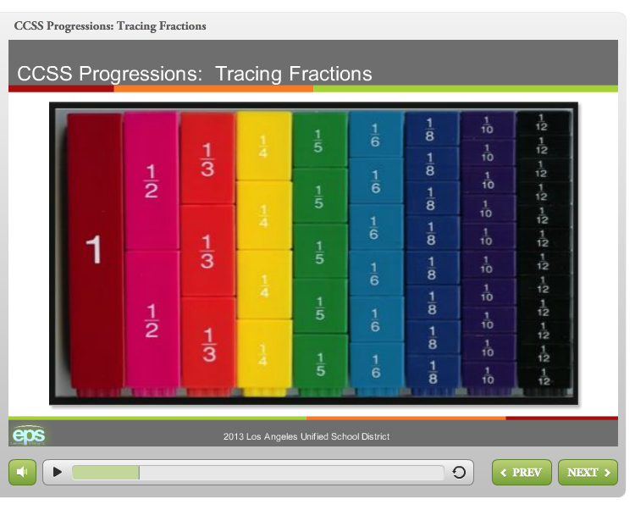
ccss.lausd.net
Facilitated Professional Development
Notes:
Instructor Notes: 30 seconds
The next four slides review available online resources
http://ccss.lausd.net/professional-development

Slide 13
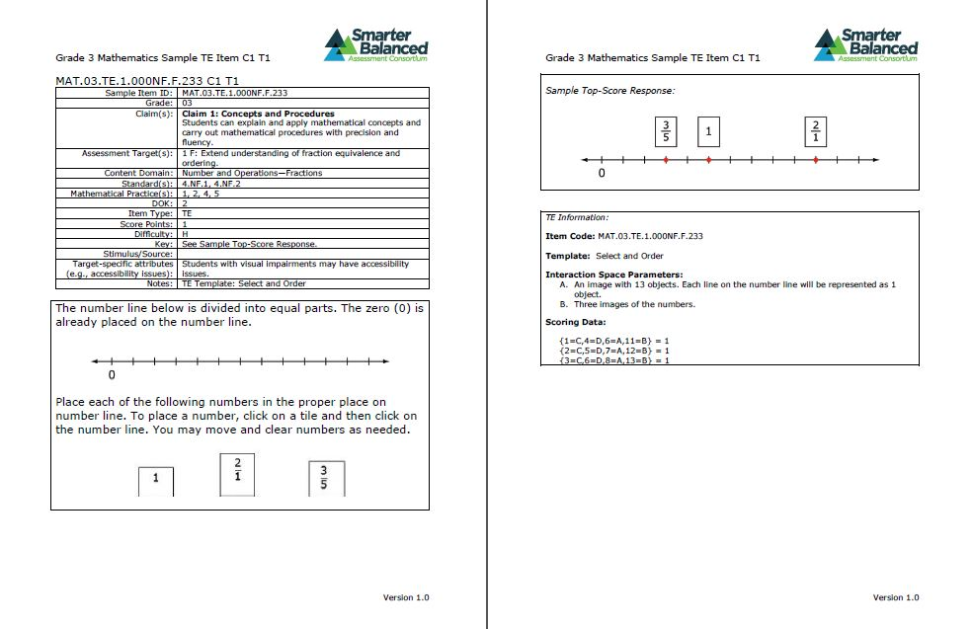
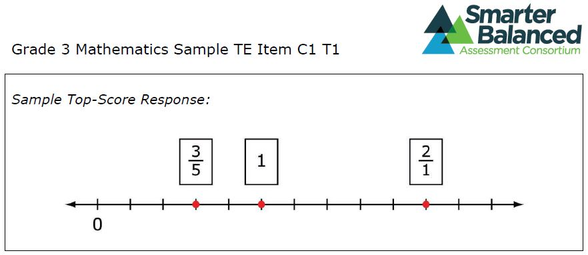
smarterbalanced.org
Pilot Tests, Sample Items & More
Notes:
Instructor Notes: 30 seconds
SBAC Practice Test
https://sbacpt.tds.airast.org/student/
SBAC sample items by sorted by grade level
http://dese.mo.gov/divimprove/assess/sbac.html#sbaccample
Scroll to the bottom of the page to find PDFs of sample items

Slide 14
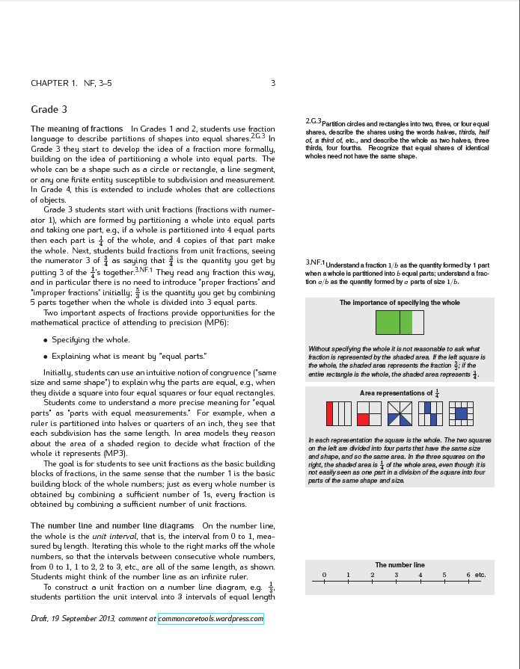
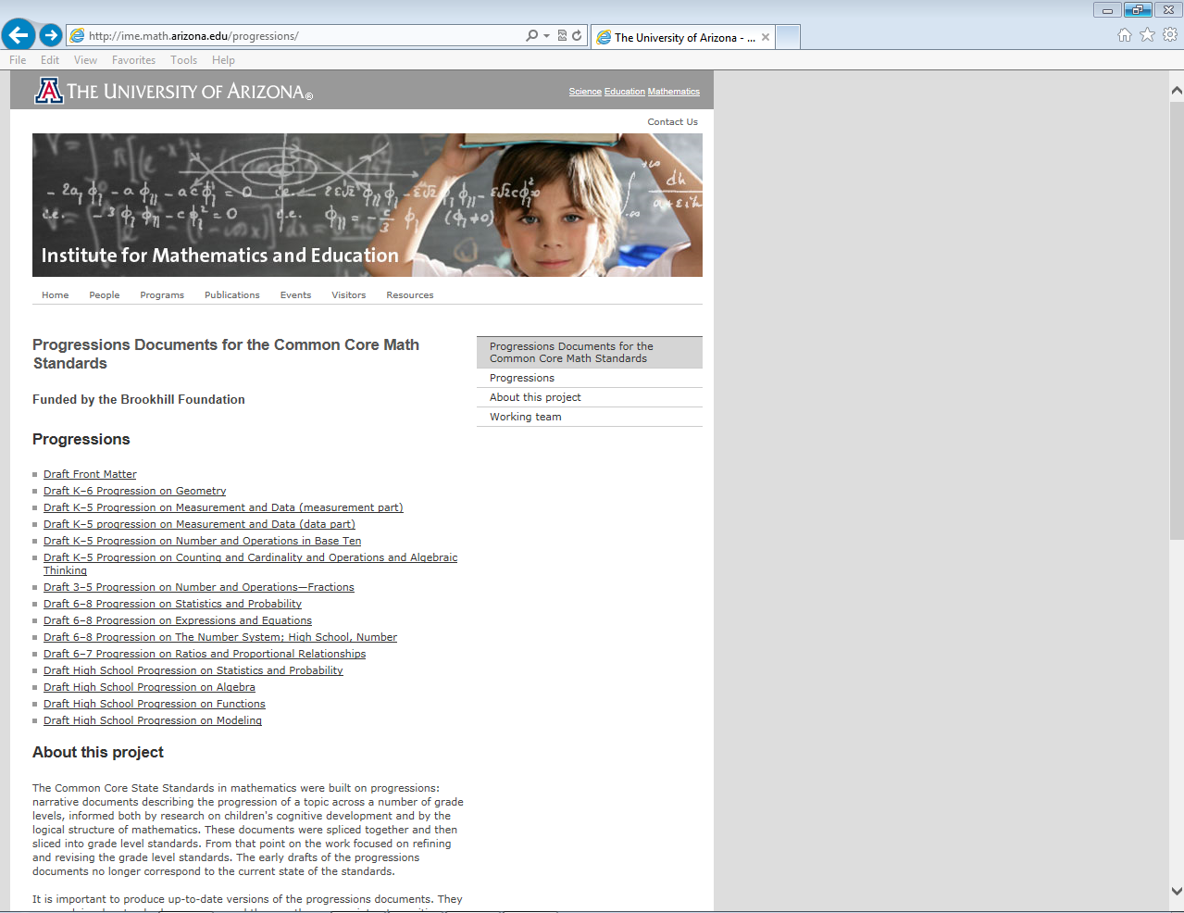
ime.math.arizona.edu/progressions
Common Core Fraction Progressions & More
Notes:
Instructor Notes: 30 seconds
Review slide
http://ime.math.arizona.edu/progressions/

Slide 15
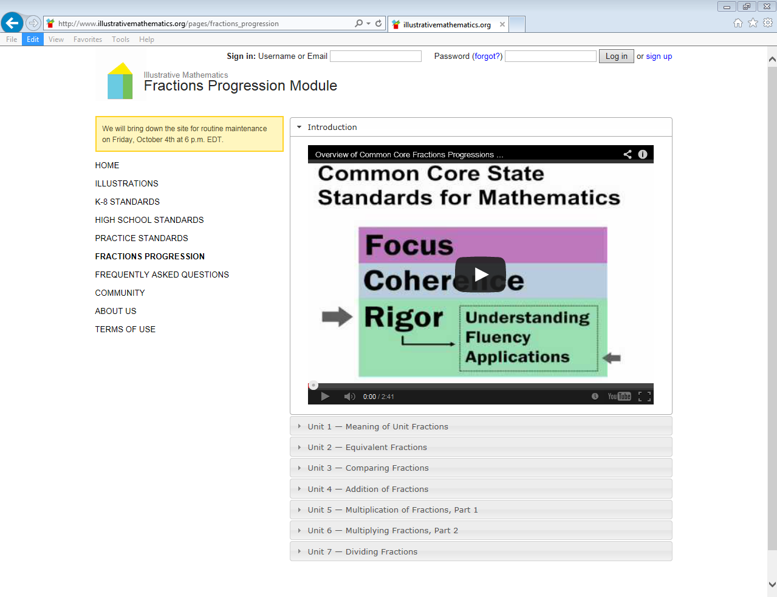
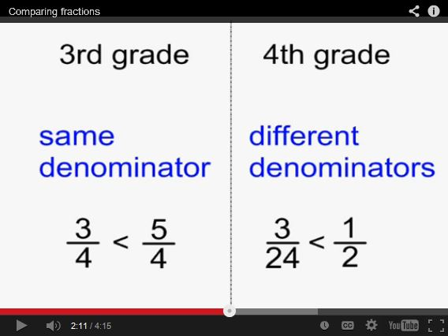
illustrativemathematics.org
Fraction Videos, Explanations, Tasks, & More
Notes:
Instructor Notes: 30 seconds
Review slide
http://www.illustrativemathematics.org/pages/fractions_progression

Slide 16
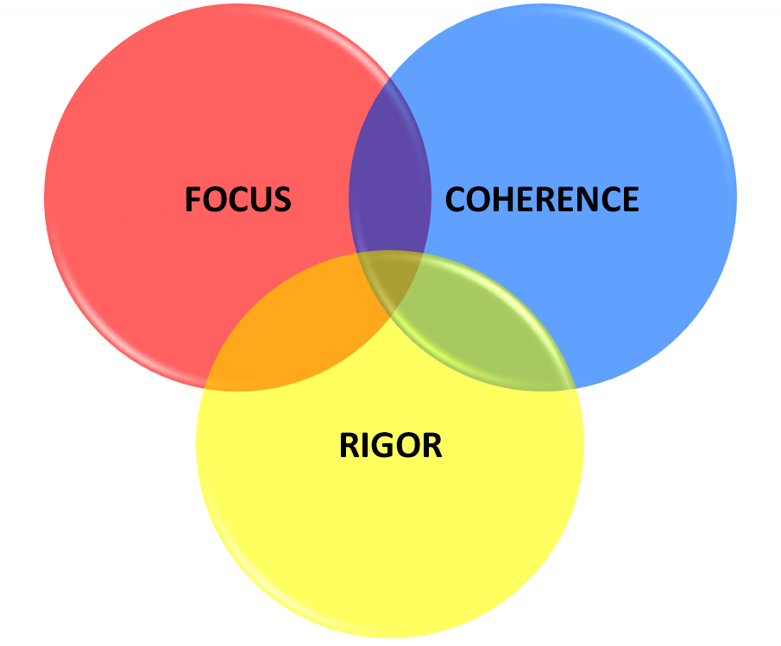
CCSSM Instructional Shifts
Focus: Instruction is focused on grade level standards.
Critical areas help us strategically focus our instruction.
Notes:
Instructor Notes: 30 seconds
One of the District 2013-14 math goals is to continue to understand and use the Common Core instructional shift “Focus.”
Focus means: teach the content of the grade level
It’s a move away from "mile wide, inch deep" curricula identified in TIMSS.
“Less topic coverage can be associated with higher scores on those topics covered because students have more time to master the content that is taught.” – Ginsburg et al., 2005
Review slide

Slide 17
CCSSM Instructional Shifts
Coherence: Instruction should be attentive to learning across grades and linking major topics within grades.
Collaboratively analyzing critical areas equips us to make connections between grade level concepts.
Notes:
Instructor Notes: 30 seconds
Another District 2013-14 math goal is to begin to understand and use the Common Core instructional shift “Coherence.”
Review slide

Slide 18
CCSSM Instructional Shifts
Rigor: Instruction should develop conceptual understanding, procedural skill and fluency, and application.
Skills without conceptual understanding are meaningless. Conceptual understanding without skills is inefficient.
Without problem solving, skills and conceptual understanding have no utility. - NCTM
Notes:
Instructor Notes: 30 seconds
Another District 2013-14 math goal is to begin to understand and use the Common Core instructional shift rigor.
Review slide
Additional Facilitator Information:
The Hunt Institute
Mathematics Fluency: A Balanced Approach
http://www.youtube.com/watch?v=ZFUAV00bTwA&list=PLD7F4C7DE7CB3D2E6&index=13
The Balance Between Skills and Understanding http://www.youtube.com/watch?v=5dUQtIXoptY&list=PLD7F4C7DE7CB3D2E6&index=17

Slide 19
Session Outcome
Begin to collaboratively unpack a Common Core critical area
Notes:
Instructor Notes: 30 seconds
Review slide

Slide 20
Thank You
College and Career Readiness

